Slide 2
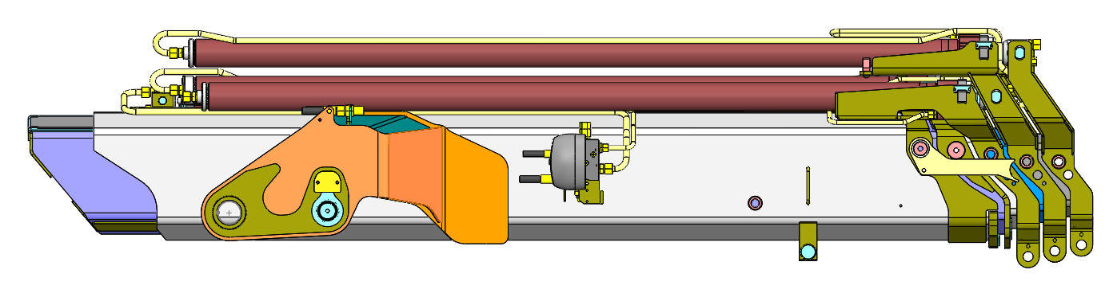
C
I

Slide 3
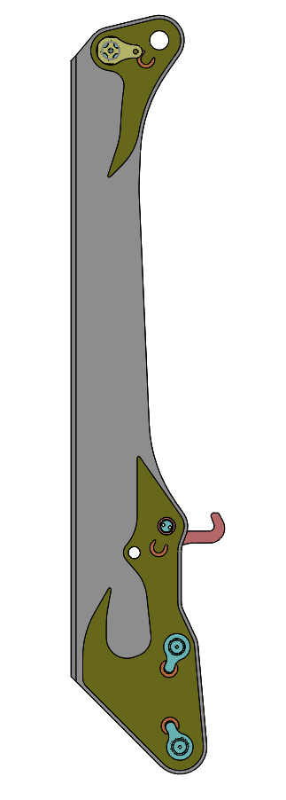
G
C
K
B
F

Slide 4
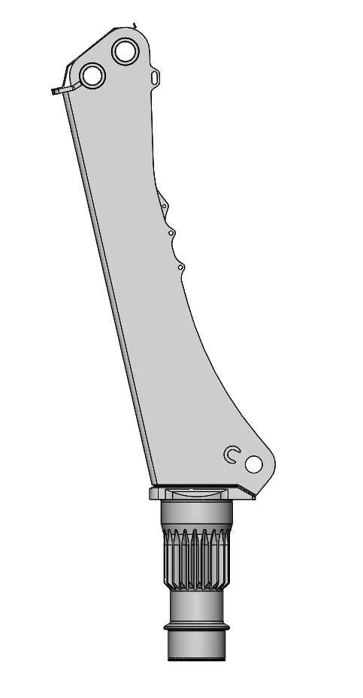
B
D
J
A

Slide 5
K
F
B

